Slide 1



Vishwakarma Institute of Technology , Pune
Department of Information Technology
Subject: Cloud Computing
Students Names :
1. Pratik Mandalkar
2. Pratik Mane
3. Netra Mohekar
4. Pranav Patel
5. Harshwardhan Patil
TY IT-B
Group 5

Slide 2


Contents
1
Literature Review
Cryptography Applications
1
8
2
Introduction
Challenges
9
3
Cloud Cryptography & its History
Benefits
10
4
Why Cryptographic Techniques
Best Practices
11
5
Cryptographic Techniques
Case Study
12
6
Data Protection
References
13
7
Protocols and Standards
2

Slide 3
Literature Review
Title | Authors | Focus Area | Source (Year)
Comprehensive Review and Analysis of Cryptography Techniques in Cloud Computing | K. Sasikumar, S. Nagarajan | Overview of cryptographic techniques in cloud computing, emphasizing elliptic curve cryptography | IEEE Xplore (2022)
New Efficient Cryptographic Techniques for Cloud Computing Security | M. Kaleem et al. | Performance comparison of emerging cryptographic techniques for cloud security | ResearchGate (2023)
Data Security Techniques in Cloud Computing Based on Machine Learning Algorithms and Cryptographic Algorithms | F. Thabit et al. | Integration of cryptographic and machine learning algorithms to enhance cloud security | Wiley Online Library (2023)
3

Slide 4
Literature Review
Title | Authors | Focus Area | Source (Year)
Cloud Computing -- An Approach with Modern Cryptography | Sugata Sanyal, Parthasarathy P. Iyer | Proposed AES based algorithm based on bit based cipher key to protect cloud based data | Arxiv.org (2023)
A Newer User Authentication, File encryption and Distributed Server Based Cloud Computing Security Architecture | Kawser Wazed Nafi, Tonny Shekha Kar, Sayed Anisul Hoque, M. M. A. Hashem | Proposed homomorphic encryption system based on elliptical curve cryptography. | Scopus (2024)
Secure file storage in cloud computing using hybrid cryptography algorithm | Punam V. Maitri, Aruna Verma | Proposed a hybrid solution based on AES, RC6 and blowfish. | IEEE (2023)
4

Slide 5
Literature Review
Title | Authors | Focus Area | Source (Year)
Analysis of Cloud Security Controls in AWS, Azure, and Google Cloud | Vyshnavi Sailakshmi | All three providers offer robust native security controls, but configuration and management differences can create gaps | Cloud State (2021)
Cloud giants: AWS, Azure and GCP | Igor Nevliudov and Svitlana Sotnik | AWS leads in overall security features and service breadth. Azure offers strong integration with Microsoft products and enterprise identity solutions. GCP excels in cost-effectiveness and modern data processing capabilities | ResearchGate (2023)
Encryption in Microsoft Azure and Amazon AWS Cloud | Surf and Xebia | AWS uses CloudHSM for dedicated, hardware-backed key isolation; Azure offers Managed HSM integrated with Key Vault with flexible key control | WIP 2023
5

Slide 6
Title | Authors | Focus Area | Source (Year)
Encryption in the Cloud: Analysing Deep into the Layers of Security | K. Sathish Kumar, Palle Jaswanth Reddy, P. GnanaTeja | The study includes Data Encryption techniques, key management practices, compliance and integration methods. | IEEE 2024
A Simple and Secured Cryptography System of Cloud Computing | SM Jahidul Islam, Zulfiker Haider Chaudhury, and Saiful Islam. | The paper proposes a cryptography system with auto-encryption and dynamic keys, manual and automatic encryption triggers. | IEEE 2019
Cloud Security using Hybrid Cryptography Algorithms | Sanjeev Kumar, Garima Karnani, Madhu Sharma Gaur, and Anju Mishra | The study proposes a multilevel cryptography model using DES and RSA algorithms, encryption at senders and the receivers ends. | IEEE 2021
Notes:
pranav

Slide 7
Title | Authors | Focus Area | Source (Year)
A Review on Cryptography in Cloud Computing | A. Jsv Sai Bhargav and Advin Manhar | By evaluating existing cryptographic methods, the paper aims to highlight their effectiveness and potential challenges in the context of cloud computing. | IJSRCSEIT 2020
Cryptography in cloud: An in-depth investigation into encryption mechanisms for safeguarding cloud-based data | John Doe and Jane Smith | It examines various cryptographic algorithms, assessing their strengths, weaknesses, and suitability for securing cloud-based data. | IJSRA 2024
A Review: Cryptography and Steganography Algorithm for Cloud Computing | Shlomi Dolev, Peter Wayner, Ron Rivest | The paper reviews cryptographic and steganographic algorithms for enhancing cloud data security. It examines encryption techniques and data-hiding methods to ensure confidentiality and integrity. The study highlights a combined approach for improved cloud security. | IEEE 2018
Notes:
pranav

Slide 8


Cloud Cryptography
Encrypts and safeguards data stored, processed, and transmitted in cloud computing environments.
Utilizes multiple security measures to prevent breaches, hacks, and malware attacks.
Ensures secure, convenient access to cloud-hosted data without causing performance delays.
6

Slide 9


During World War!?
Enigma Machine Early 1930's
Link (Enigma-German-code-device)
7

Slide 10


58-50BC Caesar Cipher used by Julius Caesar | 16 Century Vigenère Cipher used a repeating keyword to vary the substitution | 19 Century Mechanical Encryption used Enigma Machines during the world war | 1970's Diffie–Hellman key exchange introduced the concept of public-key cryptography | Present End-to-End Encryption: only the sender and receiver can read the content. Advanced Key Management: key management services (KMS) to generate, store, and rotate cryptographic keys securely. Homomorphic Encryption: enable computation on encrypted data without decryption.
6
4
3
2
1
8

Slide 11
Why Cryptographic Techniques Invented!?
Inefficiency and Performance Overhead
Diffie–Hellman require large key sizes to achieve strong security. This results
in significant computational overhead, making them impractical for encrypting
large amounts of data.
Lack of Scalability and Flexibility
Traditional algorithms were designed for static, on‑premises environments with
controlled key distribution. They don’t easily scale in dynamic, multi‑tenant
cloud settings where efficient key management.
Limited Support for Advanced Functionalities
Older schemes do not inherently support features such as fine‑grained access
control.
9

Slide 12
Cryptographic Techniques
Symmetric key cryptography
Uses one key for both encryption and decryption.
Both sender and receiver utilize the same key, ensuring secure communication.
Offers a straightforward and fast approach to encrypting and decrypting data.
10

Slide 13
Cryptographic Techniques
Asymmetric key cryptography
Uses a pair of keys, with the public key for encryption and the private key for decryption.
The public key can be shared openly, while the private key is kept confidential by the owner.
Provides improved security and versatility over symmetric key cryptography.
11

Slide 14
Cryptographic Techniques
Symmetric Key cryptography
Asymmetric Key cryptography
Advantages:
Speed & Efficiency
High Security & Compatibility
Disadvantages:
Complex Key Management
Poor Scalability
Advantages:
Enhanced Security & Flexibility
Supports Digital Signatures
Disadvantages:
Higher Computational Complexity
Complex Key Management
12

Slide 15
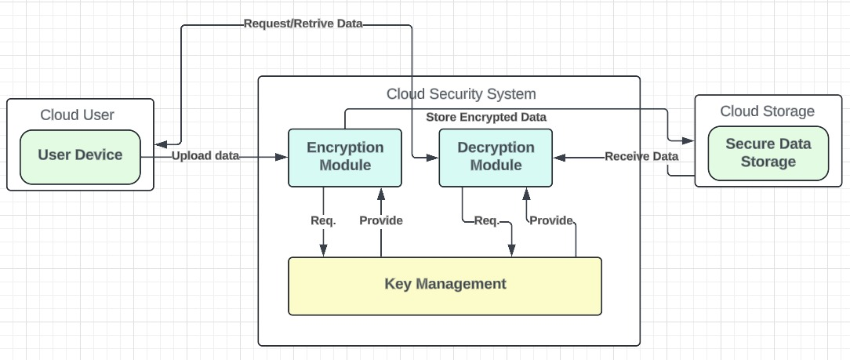
Cryptographic Architecture
Key Management Flowchart[6]
@Pratik Mandalkar 2025
13

Slide 16
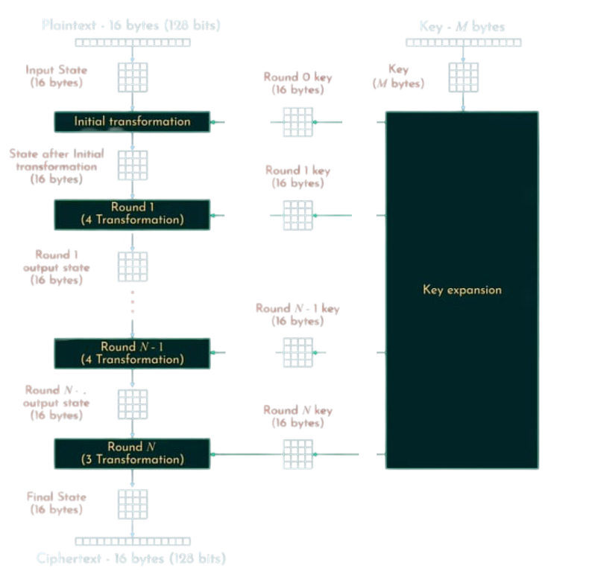
Cryptographic Algorithm
AES (Advance Encryption Standard) [5]
13

Slide 17
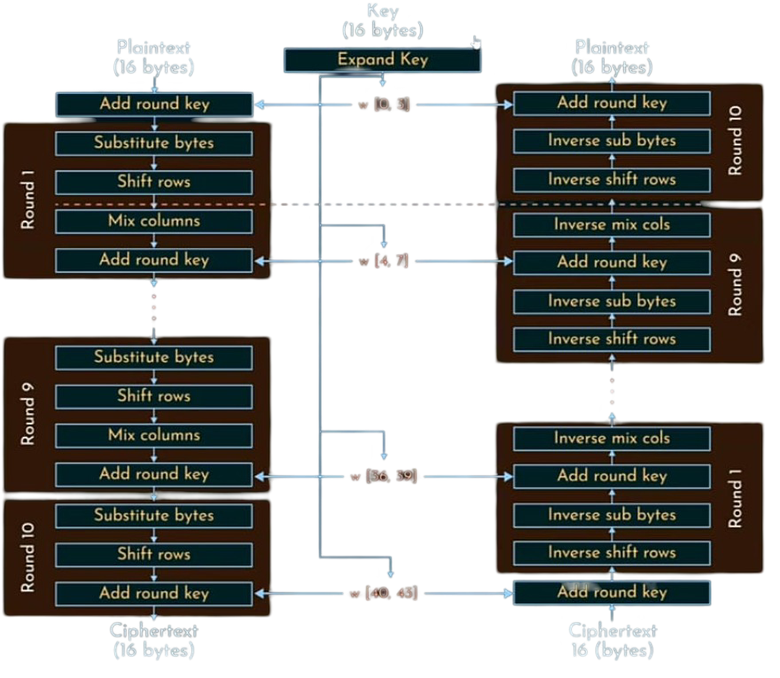
Cryptographic Algorithm
AES Encryption & Decryption [5]
14

Slide 18
Cryptography of Cloud Providers (Encryption)
AWS uses services like Amazon S3 Server-Side Encryption and Amazon storage services encryption to secure data at rest using AES-256.
Azure encrypts data at rest via services such as Azure Storage Service Encryption and Azure Disk Encryption.
Google Cloud automatically encrypts all data before it is written to disk, both at rest and in transit, using strong encryption algorithms like AES-256.
15

Slide 19
Benefits
Compliance with Regulations – Helps meet industry security standards (e.g., GDPR, HIPAA).
Protection Against Insider Threats – Prevents unauthorized employees from accessing sensitive data.
Data Integrity Assurance – Ensures data remains unaltered using hashing and digital signatures.
Scalability & Flexibility – Encryption solutions can expand with business needs.
Zero Trust Security Model – Requires strict identity verification for every access request.
16
Notes:
pranav

Slide 20
Disadvantages
Performance Impact – Encryption/decryption slows down data processing.
Key Management Issues – Losing or mismanaging keys can make data inaccessible.
Higher Costs – Strong encryption often requires extra tools or services.
Limited Data Usability – Encrypted data can't be easily searched or analyzed.
Risk of Misconfiguration – Weak or incorrect setups can expose vulnerabilities.

Slide 21
Best Practices
Use Strong Encryption Standards – Implement AES-256, RSA, or ECC for encryption.
Manage Encryption Keys Securely – Store keys using cloud-based KMS solutions (AWS KMS, Azure Key Vault).
Implement Multi-Factor Authentication (MFA) – Require multiple authentication methods for user verification.
Secure APIs and Interfaces – Use OAuth 2.0 and TLS 1.3 for encrypted API communication.
Enable Homomorphic Encryption Where Needed – Perform computations on encrypted data without decryption.
17
Notes:
pranav

Slide 22
Applications
Google Drive & OneDrive encrypt stored files using AES-256 to protect user data.
PayPal & Stripe use TLS encryption for secure online financial transactions.
Hospitals & EHR Systems encrypt patient records to ensure HIPAA compliance.
WhatsApp & Signal implement end-to-end encryption for private messaging.
Smart Homes & IoT Devices use cloud cryptography to secure connected gadgets.
17
Notes:
pranav

Slide 23
Case Study: Cloud Cryptography in Enterprise Security
A financial services company needed secure cloud data storage while ensuring regulatory compliance (GDPR, PCI-DSS).
Key Challenges:
Unauthorized access & insider threats.
Compliance risks & encryption overhead.
Cloud Cryptography Implementation:
Encryption: AES-256, TLS 1.3, Homomorphic encryption.
Key Management: Customer-Managed Keys (CMK), HSMs, Automated Key Rotation.
Access Control: MFA, Role-Based Access (RBAC), Attribute-Based Encryption (ABE).
Blockchain Security: Private blockchain for fraud prevention
18
Notes:
pranav

Slide 24
Case Study: Cloud Cryptography in Enterprise Security
Key Results:
60% reduction in data breach risks.
Regulatory compliance achieved.
Secure fraud detection using homomorphic encryption.
Challenges: High initial costs, key management complexity, employee training.
Future Plans:
Zero Trust Security Model (ZTA).
Post-Quantum Cryptography (PQC).
AI-driven threat detection.
Conclusion: Cloud cryptography ensured data security, compliance, and fraud prevention with minimal system impact.
19
Notes:
pranav

Slide 25
Real-World Case Study: Cloud Cryptography Across Industries
Case 1: American Medical Collection Agency (AMCA) – Failure due to weak cloud security
Cloud Use: Yes (3rd-party hosted databases, unclear encryption standards)
What Happened: Hackers breached servers and stole sensitive information of ~25 million patients.
Root Cause:
Poor encryption controls — unencrypted or weakly encrypted PII.
Lack of cloud infrastructure monitoring, misconfigured servers.
No apparent use of key management systems (KMS) or zero trust architectures.
Impact: Bankruptcy filed within a year of the breach.
20

Slide 26
Real-World Case Study: Cloud Cryptography Across Industries
Case 2: Coinbase – Success due to strong cloud cryptography
Cloud Use: Fully cloud-native with AWS + custom security stack
Cryptography Strategy: AES-256 encryption at rest, TLS 1.3 in transit
HSMs (Hardware Security Modules) and KMS for key handling
Zero Trust Security and multi-layer encryption
Results:
No data breach since inception.
Trusted by 100+ countries, 108 million users (as of 2024).
21

Slide 27
References
Stallings, W. (2020). Cryptography and Network Security: Principles and Practice (8th ed.). Pearson.
Rivest, R. L., Shamir, A., & Adleman, L. (1978). A Method for Obtaining Digital Signatures and Public-Key Cryptosystems. Communications of the ACM, 21(2), 120-126.
Diffie, W., & Hellman, M. (1976). New Directions in Cryptography. IEEE Transactions on Information Theory, 22(6), 644-654.
Menezes, A. J., van Oorschot, P. C., & Vanstone, S. A. (1996). Handbook of Applied Cryptography. CRC Press.
Boneh, D., Gentry, C., & Waters, B. (2005). Collusion Resistant Broadcast Encryption with Short Ciphertexts and Private Keys. Advances in Cryptology - CRYPTO 2005.
NIST. (2021). Post-Quantum Cryptography Standardization. National Institute of Standards and Technology.
ResearchGate. (2023). Cloud Giants: AWS, Azure, and GCP – A Comparative Study.
Goldreich, O. (2013). Foundations of Cryptography: A Primer. arXiv.
22
Notes:
pranav

Slide 28
References
IEEE. (2024). Proceedings of the International Conference on Emerging Computer Applications (ICOECA). IEEE Xplore.
Feng, X., Yu, T., & Ren, K. (2019). Enabling Efficient and Privacy-Preserving Multi-Keyword Ranked Search Over Encrypted Cloud Data. IEEE Xplore.
Kumar, S., & Sharma, P. (2021). A Review on Security Issues and Solutions in Cloud Computing. IEEE Xplore.
Sharma, A., & Verma, R. (2020). Cryptography in Cloud Computing: A Review on Secure Data Storage and Transmission. International Journal of Scientific Research in Computer Science, Engineering and Information Technology (IJSRCSEIT), 6(6).
IJSRA. (n.d.). Cryptography in the Cloud: An In-Depth Investigation of Encryption Mechanisms for Safeguarding Cloud-Based Data. International Journal of Scientific Research and Applications (IJSRA).
Yang, C., Xu, C., & Li, Y. (2018). A Secure Data Sharing and Storage Scheme in Cloud Computing. IEEE Xplore.
St. Cloud State University. (2021). Cloud Security Frameworks and Risk Mitigation Strategies. St. Cloud State University Repository.
23
Notes:
pranav

Slide 29




Thank you!
24

